Slide 1
Association Meeting Spring 2025
Presented by: Mark James Miller
President, Part-Time Faculty Association of Allan Hancock College, CFT Local 6185
Part-time English Instructor at Allan Hancock College since 1995
Agenda: Highlights of our collective bargaining agreement
Other important contract articles
Q & A
Membership Report: Monique Segura

Slide 2
Contract Highlights
12% increase across the board, effective Fall Semester 2023
Office Hour Pay increased to $40 per hour (from $35)
Additional week added to office hours; now 16 weeks rather than 15
Labs are now included in office hour eligibility
Overall credit load determines eligibility now
We can now send our office hour timesheets directly to ahchr@hancockcollegecollege.edu, rather than going through our dean or supervisor; should streamline the process!

Slide 3
Professional Development
Increased from a max of 4 hours to a max of 6 hours per semester
2 hours per semester length class or equivalent to a maximum of 6 hours per semester, paid at activity rate
And an additional 4 hours supplemental once your contract PD has been used up!

Slide 4
Sick Leave
Ratio now 15:1 instead of 16:1
We now get 1 hour for every 15 hours worked instead of 1 for every 16 hours
If you are in the Defined Benefits Program with STRS, your unused sick leave rolls into your service credit when you retire, increasing your monthly payment.

Slide 5
Stipend for evaluations:
Stipend for evaluating another bargaining unit member increased to $200 (from $150)

Slide 6
Stipend for distance education training:
If you elect to take the now required 30 hours of training to teach online (If you haven’t taught online before) you will be paid $60 per hour, $1800 total, the same as full-time.
If you have taught online already, but want to refresh your skills, you can take the new training as well.
At first the district wanted to pay us at our activity rate, but we insisted on getting the same as full time (parity, by any other name)

Slide 7
Coaches’ stipends increased
Men and Women’s $25,000 (from $9,000)
Men and Women’s Track $25,000 “
Women’s Volleyball $20,000 “
Men’s Soccer $20,000 “
Women’s Soccer $20,000 “
Men and Women’s Cross Country $15,000 “
Men and Women’s Golf $15,000 “
Women’s Wrestling $15,000 “

Slide 8

Bumping Rights

Slide 9
“Bumping” Rights
If you are a credit instructor in Pool 2, and you are “displaced” by a full-timer in order to make load…
You have the right to “bump” the least senior person in your department to get back to the load you had before being displaced

Slide 10

Extra large class size stipend

Slide 11
Extra-large class size stipends
If you teach a class with 60 students or more you will receive a stipend equal to what full time receives (parity, by any other name!)

Slide 12
Nothing lost!
We did not give up anything!

Slide 13
And Best of All:
We Still Have…

Slide 14

Free Parking!

Slide 15

Coming Soon: P.D. on How to Use AI in the classroom!

Slide 16
Other highlights
Step increases every 2 years instead of 3
Right to due process in disciplinary matters
State parity funds added to the salary schedule
Representation on councils and committees
Representation on hiring committees

Slide 17

Who We Are
The Part-Time Faculty Association of Allan Hancock College—California Federation of Teachers Local 6185
Affiliated with the California Federation of Teachers and The American Federation of Teachers
CFT headquarters in Sacramento
www.cft.org
AFT 1.8 million members nationwide
Headquarters in Washington, DC
www.aft.org
To join: https://cft.org/sites/main/files/file-attachments/cft_statewide-membership-form.pdf

Slide 18
Who We Are
The Part-Time Faculty Association of Allan Hancock College:
Founded in 1999
We represent approximately 700 part-time teachers, counselors, librarians, and other academic workers, at Allan Hancock College
Negotiated our first 3 year collective bargaining agreement in 2001
Governed by an Executive Board elected by our members:
Mark James Miller, President;
Beverly Garcia, Vice President
Joan Bergstom Smith, Secretary-Treasurer
Kassi Harris, our CFT Representative
Members at Large: Michael McMahon, Monique Segura, Michelle Machado, David Yundt, Patricia Koivisto, Sonny Lopez

Slide 19
Where We Are
Address: 426 E. Barcellus, Suite 103, Santa Maria, CA 93454
Phone: 805-352-0145
Fax: 805-352-1318
Email: ahcpfa@verizon.net; mark@pfaofahc.com
Website: www.pfaofahc.com (work in progress!)
Executive Board Meetings every 2nd and 4th Thursday, 3—5 PM
Members are welcome to attend

Slide 20
What We Do
Represent members of our bargaining unit in the collective bargaining process
If you are in our bargaining unit, you are automatically covered by our collective bargaining agreement
Represent our members in the grievance process
Represent our members in the employee disciplinary process
Strive to improve pay and working conditions for our members
Assist our members in other related ways, such as with unemployment insurance during summer and winter break, and interim sessions

Slide 21
Due Process & Seniority Rights
“Due process” in employee discipline, and the right to be notified in advance if you are summoned to a meeting with a dean/supervisor if this meeting could result in disciplinary action against you. You also have the right to union representation
Seniority rights for credit instructors after 3 successful evaluations and 8 assignment periods

Slide 22
Highlights Continued
Parity definition improved from 76% to 81%--a small but significant change—it took years to get this!
State parity funds added to our salary schedule in 2013
Parity with Full-time in Office Hours
Improved evaluation process
The right to be notified of any negative material placed in your personnel file, and the right to respond to this material
The right to see what is in your file

Slide 23
Highlights Continued
Article 11.7 provides us with a subsidy of $28,000 per year as “reimbursement for Association Business.” Covers the rent for our office, office supplies, utilities, etc.
Article 11.6.3 provides a fund of $30,000 per year to pay for attending shared governance and committee meetings, department meetings, and professional development activities.
Article 11.6.1 stipulates that a bargaining unit member who presents a professional development activity will be paid two hours at their activity rate for every hour of presentation.

Slide 24

Evaluations

Slide 25
Evaluations
Covered in Article 13 of our Collective Bargaining Agreement
If a new hire, you should be evaluated during your first and second semester
If successful, you will be evaluated again before your 6th semester, for your “Gateway” evaluation
If satisfactory, then you move into “Pool 2” and have seniority rights, modeled after the full-time contract

Slide 26
Evaluations
You can request a different evaluator if the one assigned to you doesn’t work out
This can even be a part-timer in your department who is in Pool 2; for non-credit, 1 year experience in that field
You and your evaluator can work out a day/time mutually agreeable for your classroom visit
You can put together a “professional portfolio” to highlight your strengths and accomplishments
You have the right to challenge in writing anything negative said about you on your evaluation

Slide 27

Disciplinary Issues

Slide 28
Disciplinary Issues
Covered in Article 17 of the CBA
If summoned to a meeting with your dean/supervisor, you must be told in advance if this meeting could result in disciplinary action against you
You have the right to “due process” and to have a union representative present

Slide 29

Student Discipline

Slide 30
Student Discipline
Go to: : https://www.hancockcollege.edu/complaints/conduct.php
Don’t be afraid to use the Notice of Instructor’s Discipline
Create a paper trail
Document times and dates of incidents
Call campus police when confronting a student
Important because if a student is acting up in your class they are probably acting up in another

Slide 31
Seniority
Covered in Article 12 of the CBA
Pool 1: New hires
Pool 2: Two satisfactory evaluations, followed by a successful “Gateway” evaluation, and completion of 8 assignment periods. You now have seniority rights, modeled on the Full-time seniority system

Slide 32
Office Hours
Covered in Article 14 of the CBA
In 2020 we finally achieved parity with full-time for office hours; improve on that in 2023:
A 20% credit load= 1 hour per week
A 40% credit load= 2 hours per week
A 60% credit load= 3 hours per week
An office hour is 60 minutes long! (Used to be 45!)
Pay is $40 per hour, paid at the end of the semester/term
You must turn in your timesheet to HR by the end of finals week
Remember to post your office hours in your syllabus

Slide 33
Sick Leave
Accumulates year by year
If you are in STRS Defined Benefits, unused sick leave is rolled into your service credit, increasing your monthly benefit
If you are in Cash Balance, you can transfer to Defined Benefits and have your sick leave converted to service credit when you retire, (but you can’t change back to Cash Balance).

Slide 34
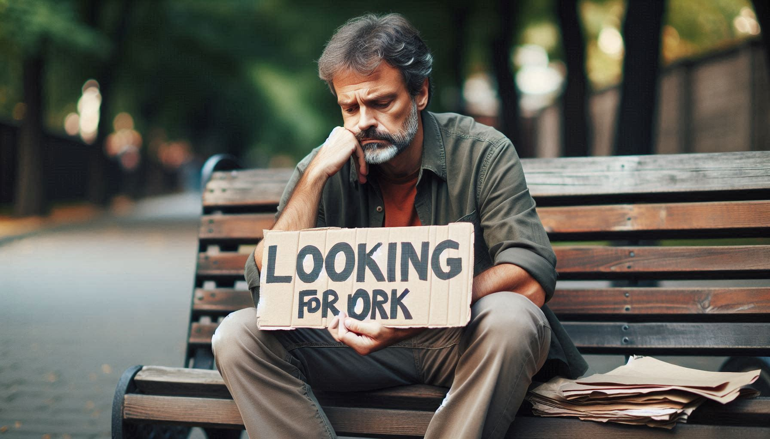
Hancock Email
Be sure to check your Hancock email
People have lost assignments for not doing so!

Slide 35
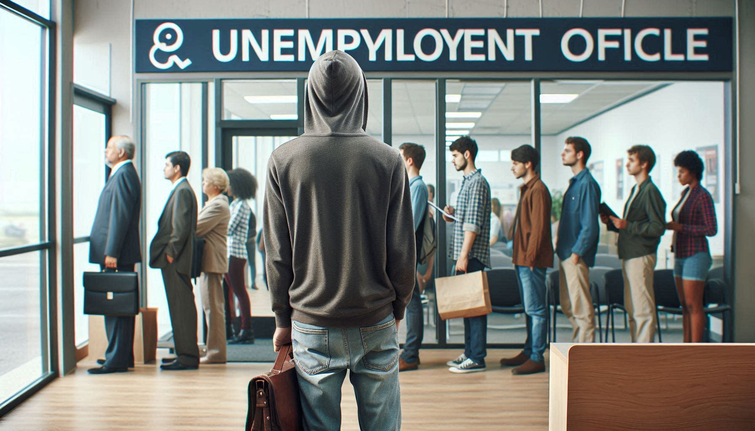
Unemployment

Slide 36
Unemployment
Depending on what other employment you may have, you may be eligible for unemployment (EDD) during summer and winter breaks, and if you lose an assignment
Apply at: http://www.edd.ca.gov/
Cite Cervisi Decision if denied: In 1989 an appeals court determined that part-time community college instructors do not have “reasonable assurance” of employment and thus are eligible for unemployment benefits
This is further reinforced in our collective bargaining agreement, Article 12.2, says specifically: “no part time faculty member shall have reasonable assurance of continued employment at any point, regardless of the status, length of service, or reemployment preference…”

Slide 37
The Future?
Continuing our fight for “equal pay for equal work”
How to grow our membership after the Janus Decision
In 2018 the Supreme Court ruled that public employee unions can no longer charge a “service fee” to non-members
However, the union must continue to represent non-members in the collective bargaining process
And non-members benefit from what the union does for them but they pay nothing in return!
Challenge is how to convince these people that the more members we have, the stronger we are and the more we can do for everyone

Slide 38
The Future
In 1954, union membership peaked at 35% of the workforce
Today it is around 10%
Union members earn on average 20% more per year than non-union, and have many other advantages as well
Unions have gotten a bad rap for many years
People think of “On the Waterfront,” or Jimmy Hoffa, when they think of unions
The challenge for us is how to counteract that

Slide 39
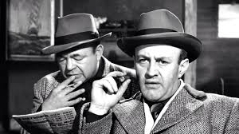
On The Waterfront: Gangsters control a longshoreman’s union

Slide 40
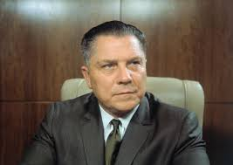
Jimmy Hoffa, Teamsters President, Vanished in 1975, allegedly had ties to organized crime

Slide 41

The End!

