Slide 1
Know Your Contract
Spring 2025
Presented by: Mark James Miller, President, Part-Time Faculty Association of Allan Hancock College
Agenda:
What we’ve accomplished
Highlights of our Collective Bargaining Agreement
The future
Q & A

Slide 2
Know Your Contract
Collective Bargaining Agreement
July 1, 2023—June 30, 2026

Slide 3
Negotiated By Your Bargaining Team 2022--2023
Mark James Miller, PFA President and Lead Negotiator
Kassandra Hawkins, CFT Representative
Domenica Devine, Bargaining Team
Joan Bergstrom Smith, Bargaining Team

Slide 4
With a Union—Without a Union
Unionized workers make an average of $200 more per week than non-unionized workers i
Before the Union: Part-Time academics at AHC were 68th of 72 California community college districts in overall pay.
Since the Union: We have moved up more than 30 places on that list (depending on step/column)
Before the Union: No office hours
Since the Union: Paid office hours
With the union: Average pay has increased by more than 100%!
i source: US Bureau of Labor Statistics

Slide 5
With a Union—Without a Union
Before the Union: No job security, part-timers could be hired and fired at will
Since the Union: Job security and due process in disciplinary matters
Before the Union: No seniority or rehire rights—you were essentially a new hire every semester
Since the Union: Seniority for credit instructors in Pool 2
Before the Union: Evaluations hit or miss—no input on the evaluator or when he/she comes to class

Slide 6
With a Union—Without a Union
Since the Union: We have a say in who evaluates us, when they come to class, and the right to challenge anything negative in your evaluation.
Since the Union: We have the right to be notified of anything negative placed in our personnel file and the right to challenge it in writing.
Before the Union: We had to pay for parking
Since the Union: Free Parking!
Before the union: Step advancement on the salary schedule every three years
Since the union: Step advancement now every 2 years

Slide 7
With a Union
In 2005, average hourly pay was $42 per hour
It would take 24 hours to earn $1000
In 2024 the average pay is $74.64 per hour, an increase of approximately 77%
In 2024 it will take a member earning the average salary 13.4 hours to earn $1000
So that person is earning 77% more and working nearly 15 hours less to earn the same amount of money!

Slide 8

Recognition and Respect
Before the Union, we got no respect

Slide 9
Recognition and Respect
We now have representation on 25 Councils and Committees!
We are an important part of the shared governance at the college
We now have 3 voting members on the Academic Senate
The college now acknowledges the important role we play
We now serve on hiring committees
We can vote for department chairs

Slide 10
Some of our accomplishments:
$62,000 in retro pay for some members of the public safety department in 2011—they had been at the wrong step on the salary schedule.
$5,300 in retro pay for a member who had been placed at the wrong step on the salary schedule.
2009 restored hours that had been cut after their contracts had been signed for members in Community Ed.
2012 restored hours (cut in 2011) for counselors.
A 20% increase for service faculty and counselors in 2015.
Summer 2008 made the administration pay in two equal installments when they tried to change it to three!

Slide 11
Accomplishments--Continued
Office hours pay increased from $13 per hour in 2005 to $40 an hour now—more than 200%!
Coaches stipends increased from a max of $9,000 to $15,000, $20,000, and $25,000!
Five additional columns added to the non-credit salary schedule, 2013
Addition of state parity funds to the salary schedule, 2013
A 20% increase in pay for service faculty in 2015
A grievance process
Due process in disciplinary matters—a member cannot be disciplined except for just and sufficient cause

Slide 12
Highlights of the Collective Bargaining Agreement 2023—2026
A 12% across the board pay increase went into effect Fall 2023
Office Hour Pay now $40 per hour
Office hours now cover all 16 weeks of the semester
Office hours calculated by credit load rather than by how many classes you teach
20% load equals 1 hour per week
40% load equals 2 hours per week
60% (or more) equals 3 hours per week

Slide 13
Highlights of the Collective Bargaining Agreement 2023—2026
Sick leave ratio increased from 16:1 to 15:1
“Bumping Rights” for Pool 2 credit instructors:
If you are displaced by a full-time instructor in order for them to make load, you can “bump” the least senior person in your department
Professional development increase to 2 hours per semester length class or its equivalent, to a maximum of 6 hours in a semester
Four additional hours available through the “supplemental” clause

Slide 14
Article 12: Workload and Assignment
We now have a straight seniority system for credit instructors, modeled after the full-time contract. New hires and those with less than 8 semesters will be placed in Pool One. Members with more than 8 semesters service will be in Pool 2, with seniority rights.
Non-credit assignments no changes; see Article 12.10

Slide 15
Article 14 Office Hours
Parity with full time: Typically, full time has five classes and five office hours.
We fought for years for this; finally achieved it in 2020. One class = 1 hour per week, 2 classes = 2 hours, 3 classes = 3 hours.
An office hour is now 60 minutes long, vs. 45 minutes previously.

Slide 16
Article 14 Office Hours
Many CCs have no office hours, or they are very few and the pay is low (minimum wage low!)
Before the union part time instructors had no office hours and were expected to meet with students on their own time, (without pay)

Slide 17
Article 13: Evaluations
If you are a new hire, you can expect to be evaluated in your first and second semesters.
If both these are satisfactory, you will be evaluated again in your sixth semester, your “Gateway” evaluation. If this is successful, you will move into Pool 2 after your eighth semester.
Once in Pool 2, you will be evaluated every six semesters, per the Ed. Code.
One exception: you can be evaluated “off cycle” if there is a documented reason for it. ii
ii We wanted to prevent the eval process from becoming a way to harass or intimidate our members

Slide 18
Evaluations Continued
The stipend for doing an evaluation is increased from $150 to $200 (for part-time evaluators only)
You can negotiate with your evaluator on the date and time he/she comes to observe your class. iii
You can request a different evaluator if you are not happy or comfortable with the person assigned. iv
You can even have a fellow part-timer do your evaluation, if he/she is qualified.
iii You may have a lesson you are especially proud of that you want the evaluator to see
iv Sometimes personalities or teaching styles conflict

Slide 19

Definition of Parity Increased from 76% to 81%--It doesn’t sound like much, but it was a long time coming!

Slide 20
Other:
You can challenge, in writing, anything negative said about you or your teaching style on your evaluation.
You have right to be notified of any negative material placed in your personnel file and respond to that as well.

Slide 21
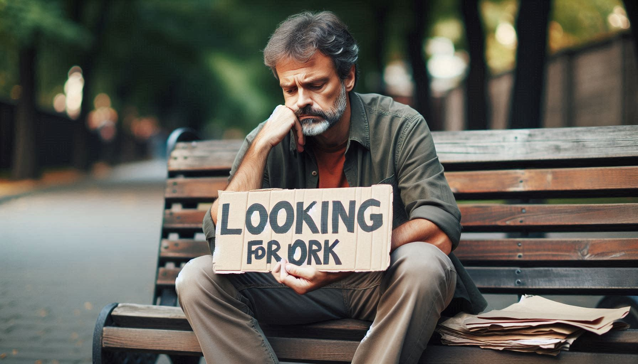
Other:
Check your Hancock email!
People have lost assignments for not checking their email

Slide 22
More Information
You have 24 hours sick leave beginning every July 1. This is not part of the contract but from the state. It does not roll over or accumulate, but it must be used before the sick leave we are provided in the collective bargaining agreement.
And Best of All:

Slide 23

We still have Free Parking!

Slide 24

Disciplinary Issues

Slide 25
Employee Discipline Article 17
It happens rarely but you need to know what your rights are and what your options are—just in case!

Slide 26
We Are Here For You
Employee Discipline:
Article 17 guarantees us “due process” in cases of discipline.
Your dean must notify you ahead of time if a meeting you are asked to attend could result in disciplinary action taken against you.
You have the right to union representation. vi
vi A member once was fired because of her accent! We got her job back for her.

Slide 27
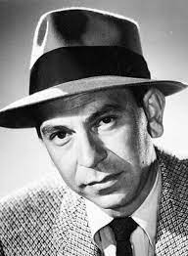
Investigations: “Just the facts, Ma’am.”
The same rights apply if you are called as part of an investigation
You can have a union representative present if you are called by an investigator

Slide 28
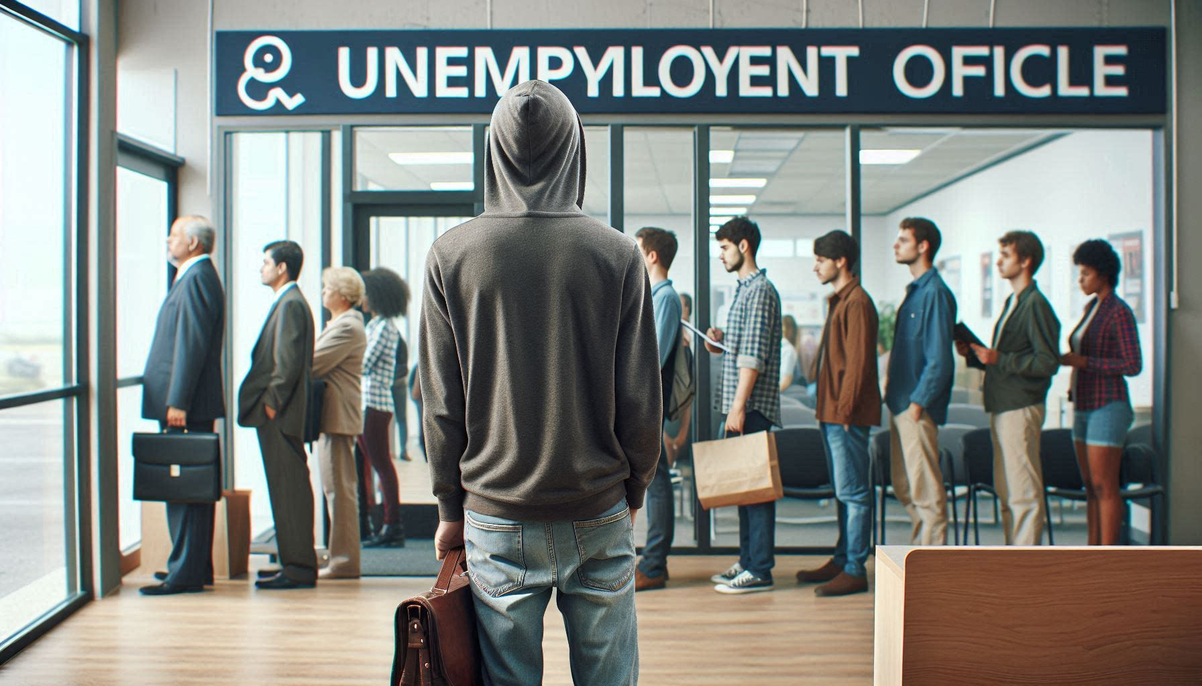
Unemployment

Slide 29
Unemployment
We are entitled to unemployment if your assignment is reduced or taken away.
As a part-time academic worker, we are eligible for unemployment during summer and during intersessions like Winter Break.
You are not telling a lie if you check “No” on the application when it asks if you have an offer of a job. Because our employment is to tenuous, and our classes can be canceled for so many reasons, like funding running out of being bumped by a -timer, the courts have ruled we do not have “reasonable assurance of employment.”
If denied, appeal and cite the “Cervisi Decision” of 1989.
Apply at http://www.edd.ca.gov

Slide 30
Unemployment
This is further reinforced in our collective bargaining agreement, Article 12.2, says specifically:
“no part time faculty member shall have reasonable assurance of continued employment at any point, regardless of the status, length of service, or reemployment preference…”

Slide 31

The Future

Slide 32
The Future?
Continuing our fight for “equal pay for equal work”
How to grow our membership after the Janus Decision
In 2018 the Supreme Court ruled that public employee unions can no longer charge a “service fee” to non-members
However, the union must continue to represent non-members in the collective bargaining process
And non-members benefit from what the union does for them but they pay nothing in return!
Challenge is how to convince these people that the more members we have, the stronger we are and the more we can do for everyone

Slide 33
The Future
In 1954, union membership peaked at 35% of the workforce nationwide
Today it is around 10%
Union members earn on average 20% more per year than non-union, and have many other advantages as well—seniority, job security, protection from retaliation, etc
Unions have gotten a bad rap for many years
People think of “On the Waterfront,” or Jimmy Hoffa, when they think of unions
The challenge for us is how to counteract that

Slide 34
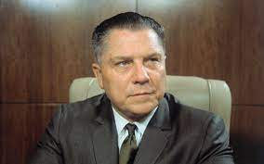
Unions have gotten a bad rap!
Jimmy Hoffa, Former Teamsters President

Slide 35
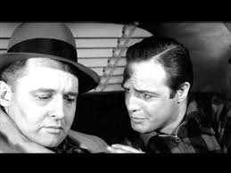
Marlon Brando “I coulda been a contender!”

Slide 36
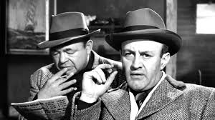
Gangsters in “On the Waterfront”

Slide 37
Unions often perceived negatively
When people think of unions they often think of corrupt unions leaders like Jimmy Hoffa of the Teamsters, or
Movies like On the Waterfront, where gangsters have taken over a longshoreman’s union
A challenge for the next generation of union leaders is to counteract that, and convince people that unions benefit them

Slide 38
The Future
Freedom isn’t free!
What we have gained over the past 20+ years did not come free or easily
Continue the fight for equal pay for equal work—parity
We are facing an existential threat from billionaire backed anti-union groups
They are funded by billionaires like the Koch Brothers and the Walton family and others who want to destroy unions completely

Slide 39
The Future
Join us!
To join:
https://cft.org/sites/main/files/file-attachments/cft_statewide-membership-form.pdf

